Slide 1




Webinar: Mobilizing Stakeholders for Effective Industrial Symbiosis Implementation
Moderator: Marianna Kambanou, Linköping University
Panelists: Johannes Lindorfer and Melanie Knöbl, Energy Institute at the Johannes Kepler University
This project has received funding from the European Union’s Horizon 2020 research and innovation programme under grant agreement No 958337.

Slide 2
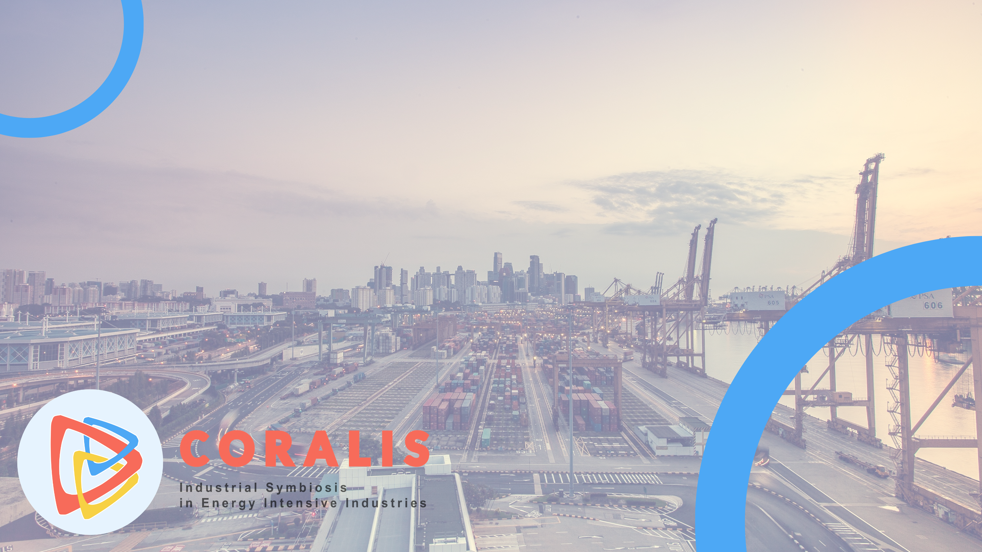
WEBINAR
Synergizing Industry: Mobilizing Stakeholders for effective Industrial Symbiosis Implementation
October 8th 2024, 13:30 – 14:30, online
Energieinstitut at the Johannes Kepler University Linz, Austria
This project has received funding from the European Union’s Horizon 2020 research and innovation programme under grant agreement No 958337.

Slide 3




Agenda
Introduction to Industrial Symbiosis and the CORALIS project
The Follower Cases
Examples of follower cases out of the H2020 CORALIS project
Stakeholder Engagement and Mobilization
Step 1 Stakeholder Definition
Step 2 Stakeholder Analysis
Step 3 Stakeholder Engagement Planning
Step 4 Stakeholders Engagement Process
Step 5 Stakeholder Engagement Indicators
Stakeholder Mobilization for enabling the implementation of Industrial Symbiosis
Case study results
Methods for Stakeholder Mobilization in Industrial Symbiosis
Recomendations for Stakeholder Mobilization in Industrial Symbiosis
Roadmapping and Action Plan for Implementation
3

Slide 4
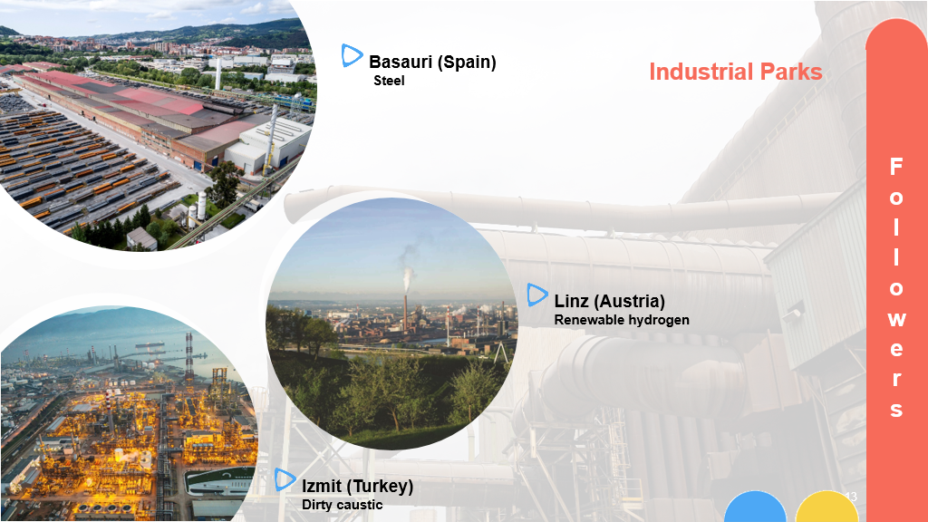

Slide 5
Overview and objectives of IS uptake in H2020 “CORALIS” “Followers”
Guidance and road-mapping for IS uptake in the Follower areas
Overview
The aim is to demonstrate the application of CORALIS approaches in the three "follow-on industry regions“ and to support stakeholder mobilization with regard to industrial symbiosis
Objectives
Perform a techno-economic and business case study of a thermal energy recovery and storage system for a steelshop and its application for the surrounding industries
Carry out a technology benchmarking and test new business models for renewable hydrogen exchange
Validate business model and management procedures for the reutilization of the spent caustic from refineries into other industries
Identifying the required stakeholders in each follower ecosystem for the implementation of symbiosis cases
Elaborate the roadmap for the implementation of the symbiosis case for each follower demonstrator
IS uptake
support
5

Slide 6
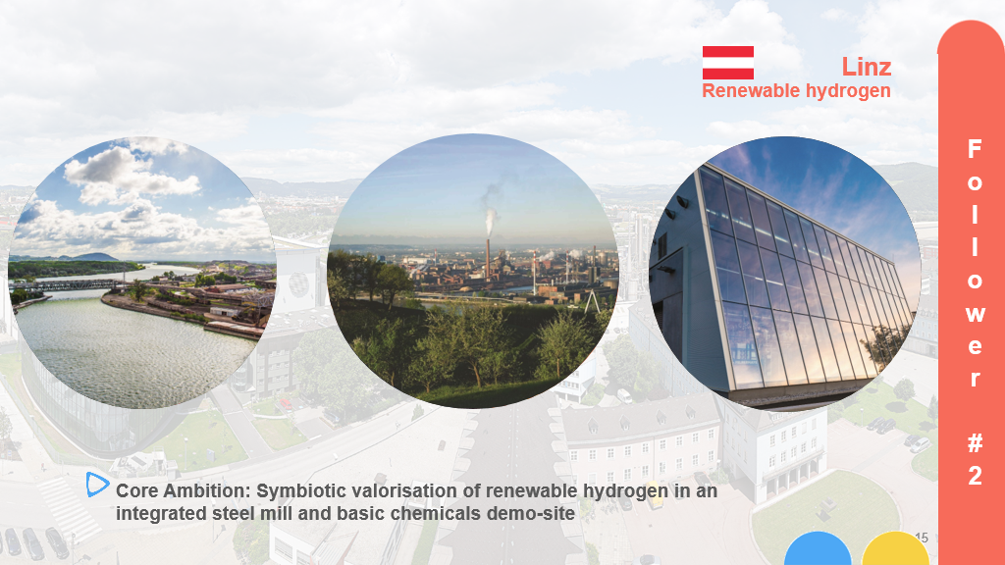

Slide 7





Definition of business models for the renewable hydrogen exchange within an industrial area (Linz case)
The project investigated options for
cooperative large-scale production,
the transport,
the storage
and the use
of renewable hydrogen for the industry site in Linz
with an integrated steel mill and ammonia fertilizer production
Complementary to this core topic, options for the
Waste heat recovery
CO₂ use
based on renewable electricity, ammonia and metallurgical gases are being investigated for their technical and economic feasibility.
H₂
H₂
2024/10/08
WEBINAR stakeholder mobilisation & roadmapping / EI-JKU
7

Slide 8
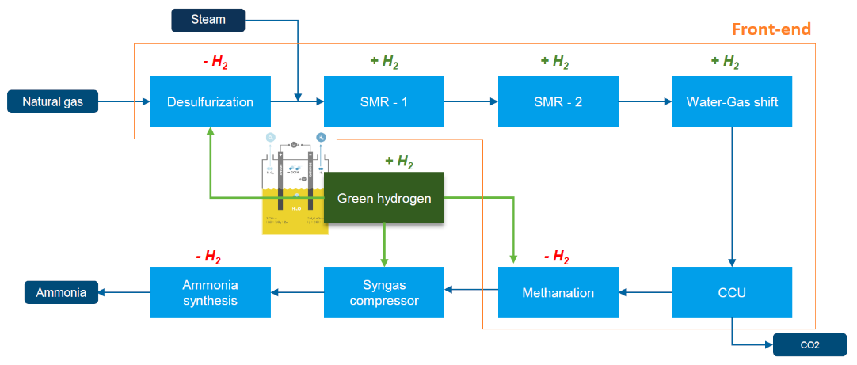
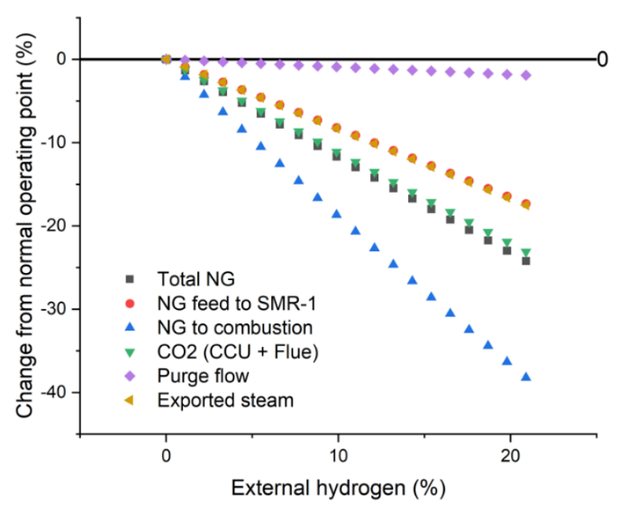
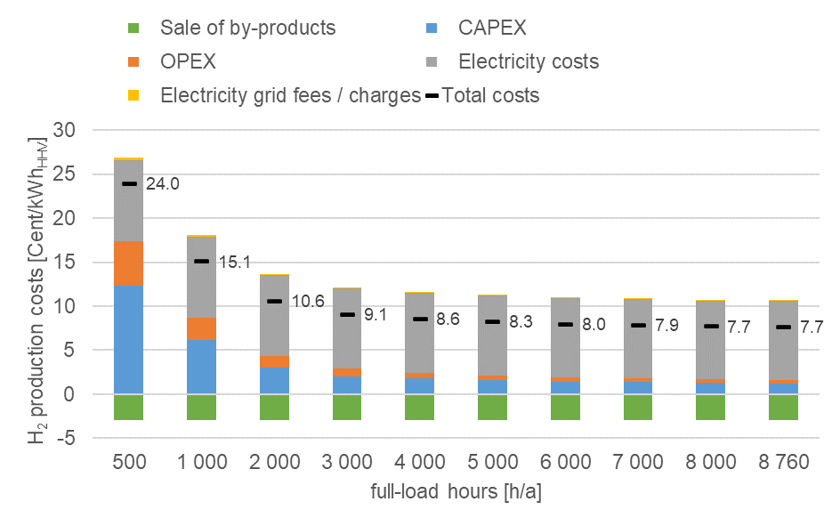
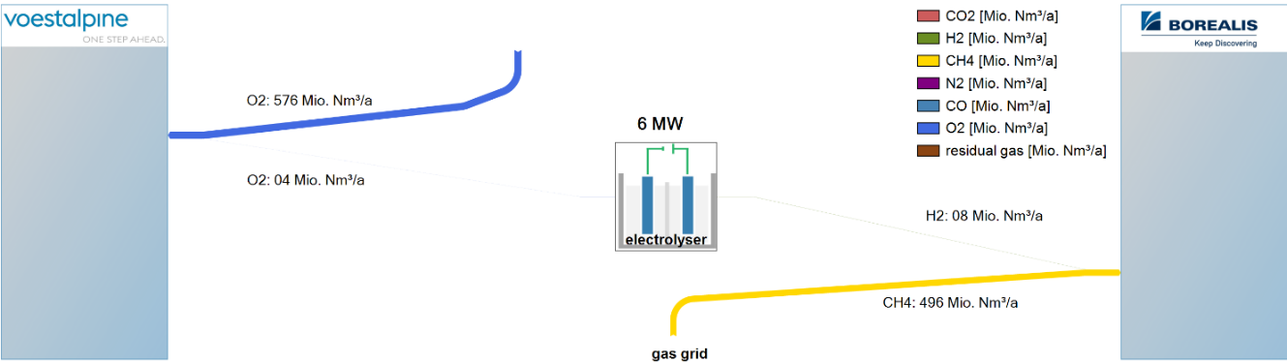
Exemplary UseCase #1 Direct renewable H₂ exchange from existing water electrolysis capacities
5 sub-use cases developed
Renewable H₂ addition to LAT ammonia production plants
Addition of renewable H₂ from existing 6 MWel PEM
Next step in on-site H₂ production: 60 MWel PEM
Theoretical future scenario
H₂ import
WEBINAR stakeholder mobilisation & roadmapping / EI-JKU
8
8

Slide 9
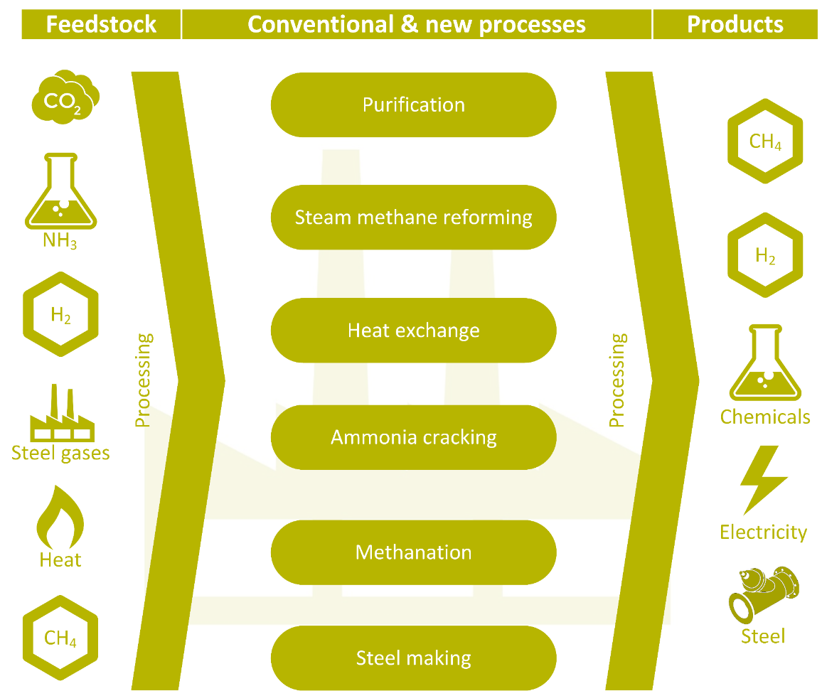
Exemplary UseCase #2-7 exchange, conversion and upgrade of process flows in neigboring industry assets
potential use cases for industrial symbiosis options were defined, analysed & discussed, e.g.
Direct renewable H₂ exchange from existing water electrolysis capacities; incl. renewable H₂ import to the site
Methanation of CO₂ to produce SNG
Methanation of off gases from the integrated steel plant
Utilisation from coke oven gas for H₂ supply
H₂ storage as ammonia and reconversion on demand
Utilisation of CO₂ for urea production
Process integration of existing and potential new assets
> 15 meetings between the local industrial partners
& accompanying research
2024/10/08
WEBINAR stakeholder mobilisation & roadmapping / EI-JKU
9
Notes:
Definition of process options for symbiosis
Evaluation of possible process couplings as part of the industrial symbiosis
Analysis of different production possibilities based on available feedstock

Slide 10
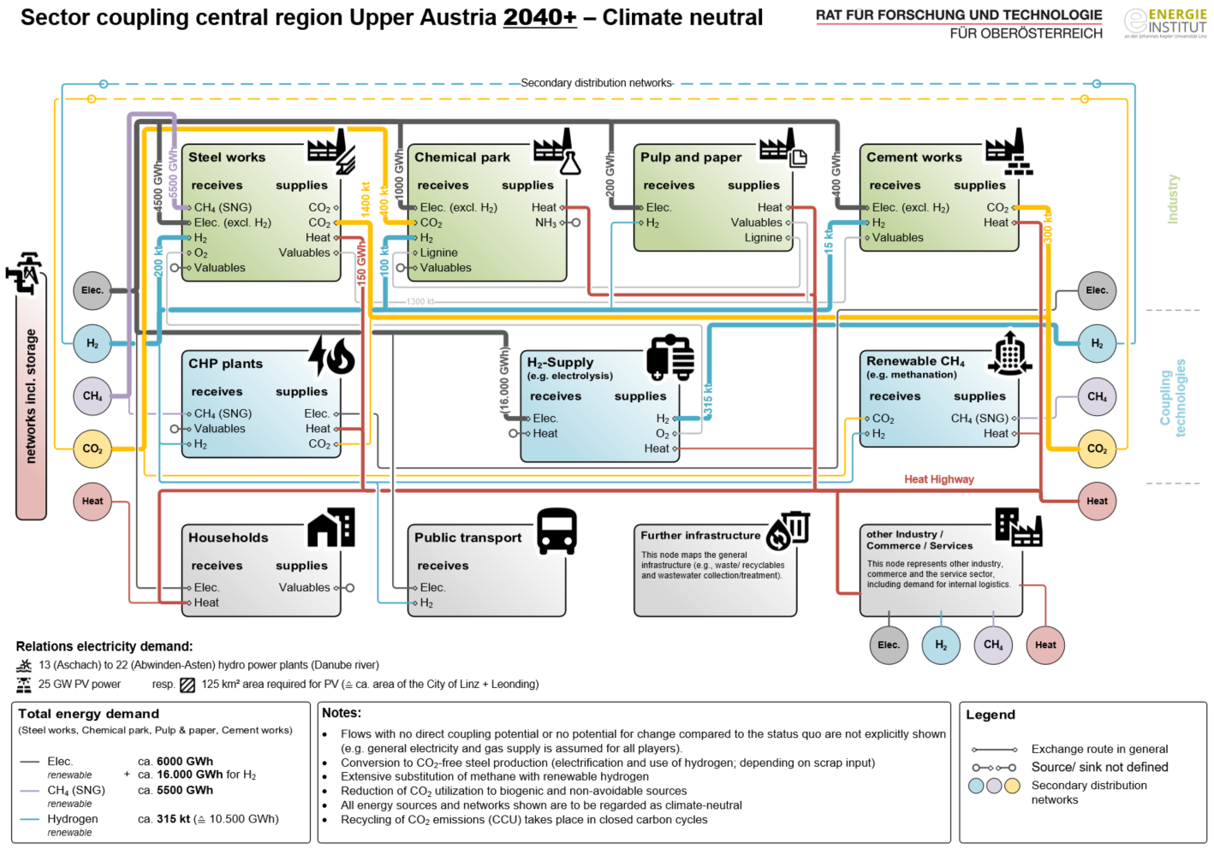

Vision for Sector coupling in the central region of Upper Austria, scenario: 2040+ – Climate neutral.
Source: Energieinstitut an der JKU Linz
2024/10/08
WEBINAR stakeholder mobilisation & roadmapping / EI-JKU
10

Slide 11
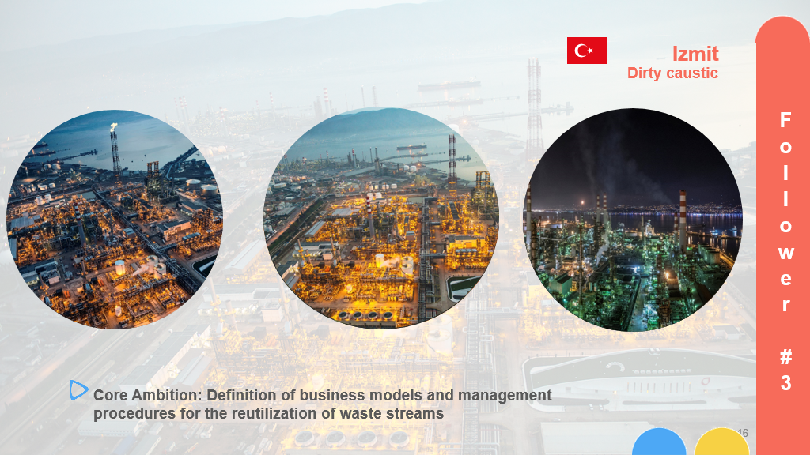

Slide 12

Feasibility assessment for the reutilisation of refinery spent caustic
Objective 1: Content Analysis of the wastes produced in the refinery
Objective 2: Research of relevant sectors where the waste can be evaluated
Objective 3: Evaluation of feasible companies / partnerships
Objective 4: Technical and economic analysis of reutilisation of refinery spent caustic
2024/10/08
WEBINAR stakeholder mobilisation & roadmapping / EI-JKU
12

Slide 13
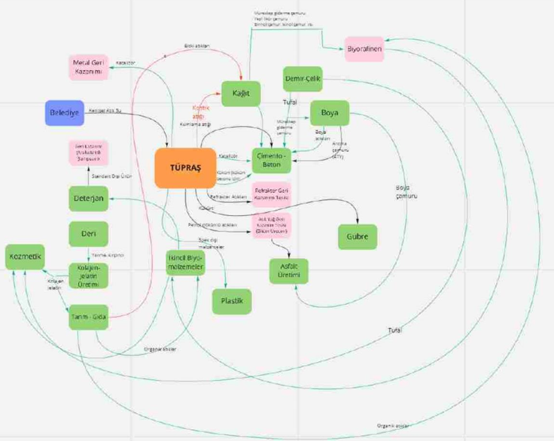
Feasibility assessment for the reutilisation of refinery spent caustic
Initial step: Visioning Workshop!
Goal: Establish a basis for a common industrial symbiosis vision in the region to motivate stakeholders and increase their engagement
28 people from 21 organizations
Content: Existing IS practices in TUPRAS
Existing IS practices in the companies attending the workshop
New IS opportunities discussed during the workshop
Challenges and limitations evaluated
Follow-up meetings planned for the identified opportunities
2024/10/08
WEBINAR stakeholder mobilisation & roadmapping / EI-JKU
13

Slide 14

Stakeholder engagement and mobilization
…as a stepwise approach
The Stakeholders engagement strategies followed a 5 step approach:
Step 1 Stakeholder Definition;
Step 2 Stakeholder Analysis;
Step 3 Stakeholder Engagement Planning;
Step 4 Stakeholders Engagement Process;
Step 5 Stakeholder Engagement Indicators.
2024/10/08
WEBINAR stakeholder mobilisation & roadmapping / EI-JKU
14

Slide 15

Stakeholder engagement and mobilization
Step 1 Stakeholders Definition
Identification of relevant actors affected by / or influencing the project
Consideration of both public and private stakeholders
Key stakeholders may include:
  Administration
  Politics
  Associations & NGOs
  Economic Players
  Press & Media
  Civil society
Ensure the right actors are involved in later project phases
2024/10/08
WEBINAR stakeholder mobilisation & roadmapping / EI-JKU
15

Slide 16

Stakeholder engagement and mobilization
Step 2 Stakeholder Analysis
Stakeholders are persons or groups of persons who have an interest in, are involved in, or are affected by the introduction of the technology, product, etc…
Literature review of stakeholder engagement in connection with IS
Identification of relevant stakeholders and their role on the implementation of a technology, product, process or service
Descriptive description of the identified stakeholders
Consideration of possible engagement activities for stakeholders
2024/10/08
WEBINAR stakeholder mobilisation & roadmapping / EI-JKU
16

Slide 17
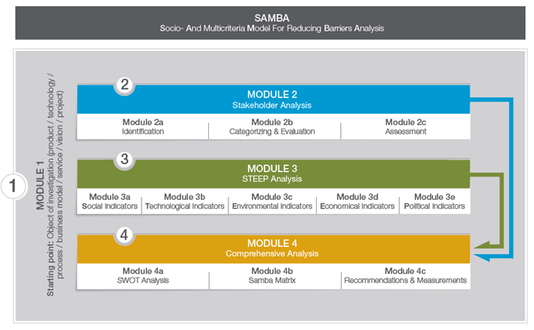
Stakeholder mobilization for enabling the implementation of the IS
Step 2 Stakeholder Analysis
  Evaluation with Energinstitut’s inhouse tool SAMBA (Socio- and multicriteria model for reducing barrier analysis).
    Stakeholder analysis (module 2) including identification, categorization and evaluation of relevant stakeholders.
    STEEP-analysis (module 3): identification and evaluation of qualitative indicators for the description of the project's environment.
    Comprehensive analysis (module 4) –developing a transparent procedure for finally deriving the barriers and constraints as well as the recommendations how to overcome these.
Source: Energy Institute at JKU Linz
2024/10/08
WEBINAR stakeholder mobilisation & roadmapping / EI-JKU
17

Slide 18

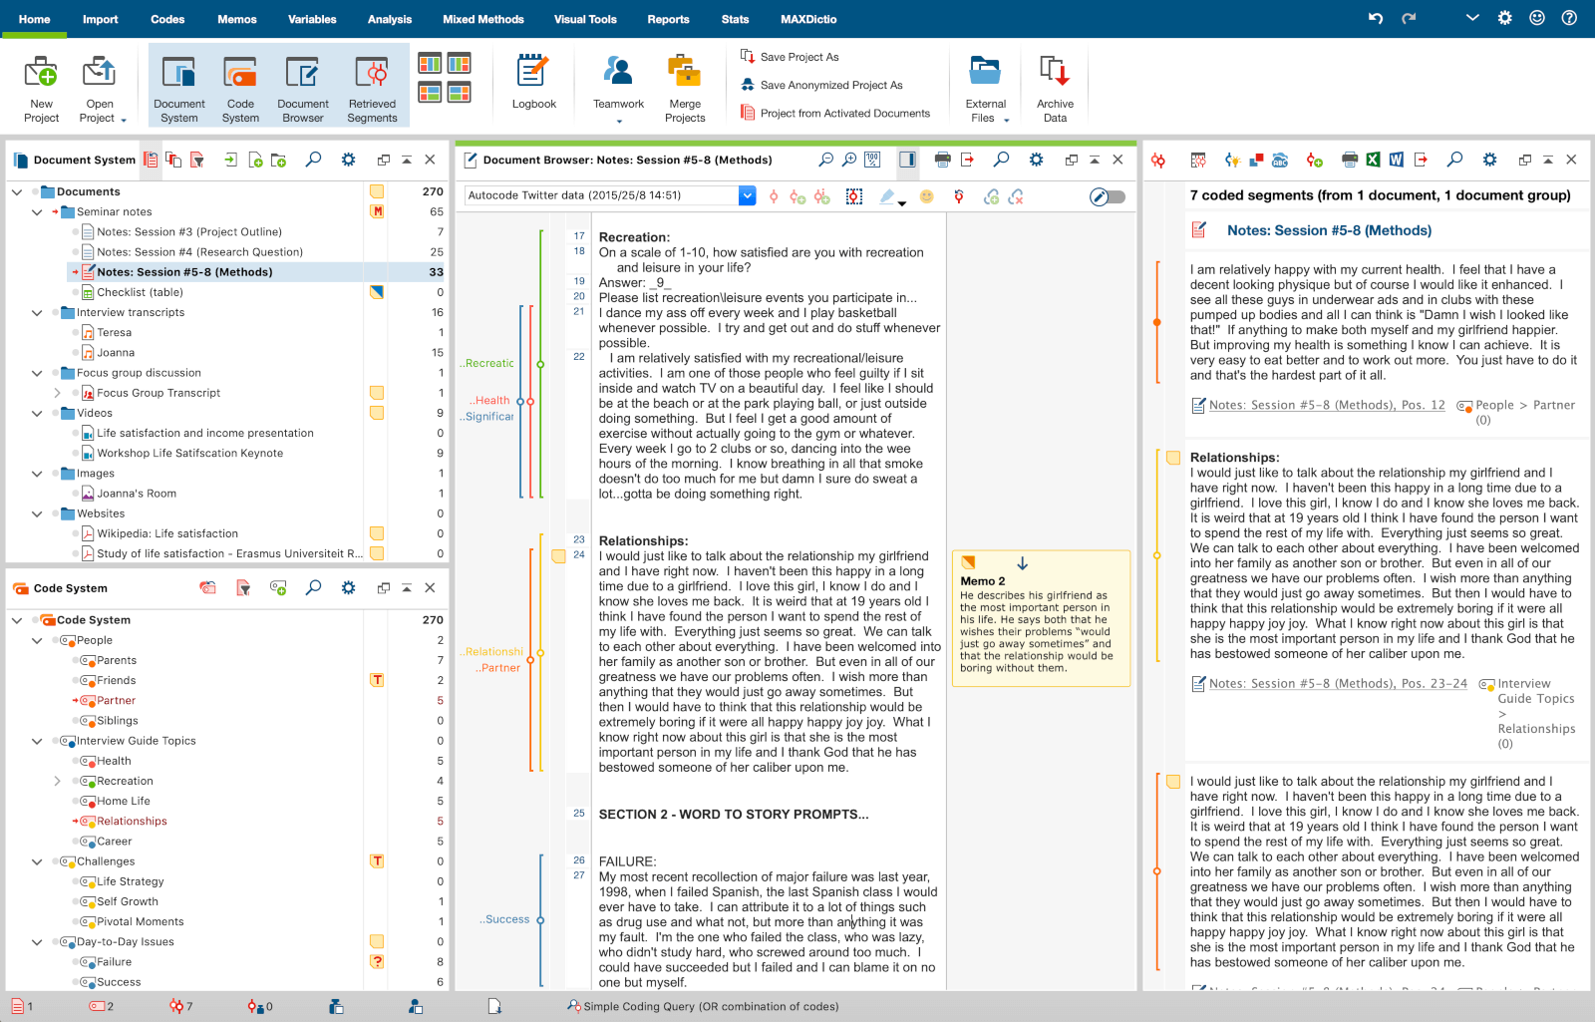
Stakeholder mobilization for enabling the implementation of the IS
Aim:
The aim is to build networks and cooperations that support the long-term realization of industrial symbiosis.
It is about identifying barriers, challenges, but also opportunities of the CORALIS project.
The identification and mobilization of stakeholders, networking within the follower cases and
aspects of social acceptance are particularly addressed.
Methodology:
Conduction of expert guided interviews
Sample: representatives of the three follower cases
Output
  Identification of possible opportunities and problems
  of cooperation in CORALIS H2020 and,
  based on this, to derive recommendations for successful implementation and networking.
18

Slide 19

Stakeholder engagement and mobilization
Step 3/4 Stakeholder Engagement Planning and Process
Builds on previous projects, experiences and ongoing exchange with the affected stakeholders (e.g. expert interviews).
Stakeholders should be actively involved right from the planning phase in order to identify their interests and needs.
Level of involevement | Involvement Strategy | Communication Strategy | Relation | Result
Informing | Newsletters, Bulletins, Brochures, Reports, Websites. Public speeches, conferences, public events. Site visits. Press conferences, publicity, lobbying. | One-side direction: stakeholders are not invited to reply or to give feedbacks. | Short or long term relation: “we’ll keep you informed” | To inform and form the stakeholders
Monitoring | Media, web and internet analysis. Possible focused interviews to the stakeholders. | One-side direction: stakeholders opinion is monitored without open debates or dialogue. | No relation | To monitor the stakeholders point of view
Negotiating | Public-Private Partnership and other Multilevel governance approaches | Limited on both sides: strongly connected to formal defined ex ante conditions and objectives. | Relationship built upon formal/contractual terms | To work together is a specific formal relation where objectives and frame work conditions are defined ex ante.
Consulting | Surveys. Focus groups. Evaluations. Individual meetings and interviews. Public events and workshops. Permanent Forums. Open discussions, feedbacks on-line. | Limited on both sides: stakeholders are invited to give feedbacks and reply to specific questions and themes proposed. | Short or long term relation: “we’ll keep you informed, we’ll take into consideration your suggestions and feedbacks, we’ll inform you about our decisions” | To obtain information and feedbacks from the stakeholders to support internal decision making process.
Involving | Forum multi-stakeholder. Consulting Committees. Consensus building processes. | Bilateral and multilateral: all the involved subjects get new information | Medium-long term involvement: “We’ll work with you to ensure that your opinion is included“ | To work closely with the stakeholders to ensure their involvement
Cooperating | Common projects and objectives, multi-stakeholders initiatives or actions. | Bilateral and multilateral: all the involved subjects are part of a negotiated decision process and work together to take common decisions. | Long term relation | To be partners, part of a network in order to develop common solutions and shared action plans.
Source: Colleselli, V. 2019: Joint Methodology Guidelines for Stakeholder Mobilization and Engagement.

Slide 20

Stakeholder engagement and mobilization
Step 5 Stakeholder Engagement Indicators
Objective of indicators:
Ensuring the success and effectiveness of stakeholder engagement
Continuous measurement and evaluation of engagement
Indicator Type | Examples of Indicators
Quantitative Indicators | - Number of involved stakeholders - Participation rate in workshops/meetings - Survey response rates
Qualitative Indicators | - Stakeholder satisfaction - Quality and relevance of input
Interaction Indices | - Communication frequency and diversity
Result-Oriented Indicators | - Implementation of stakeholder recommendations - Influence on project decisions - Long-term collaboration

Slide 21

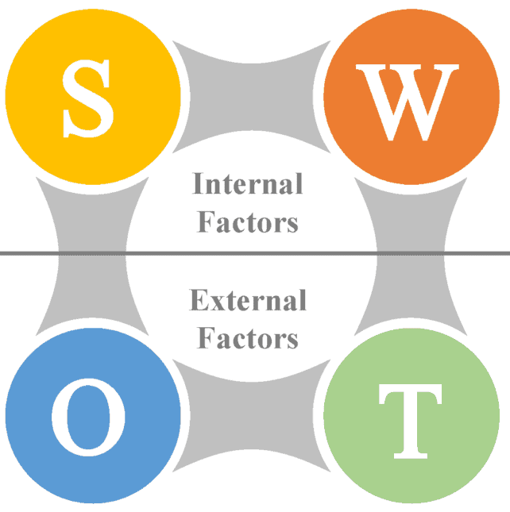
Stakeholder mobilization for enabling the implementation of the IS
Stakeholder analysis -> indicator description -> SWOT analysis
Stakeholder analysis with the aim to identify, categorize and evaluate important stakeholders in the CORALIS project
  The analysis will contain a description of relevant stakeholders and used strategies for stakeholder mobilization
  These strategies, in terms of meetings, workshops, regular exchanges etc. are also described and evaluated
Qualitative indicator description
  for an identification of possible/existing external barriers and challenges.
  Those (social/societal, ecological, economic, technological, political) indicators will
  be based on literature review, expert knowledge, internal know-how, previous analyses.
Derivation of an adapted SWOT analysis
  to illustrate the change process in the project.
The results serve as a basis for the subsequent road mapping and be applied for this purpose.
https://www.101planners.com/swot-analysis-template/
21

Slide 22
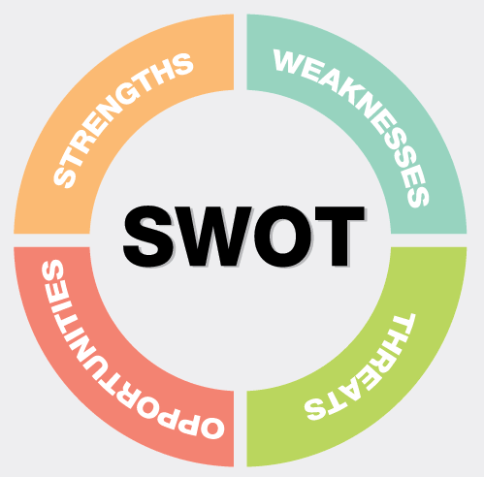
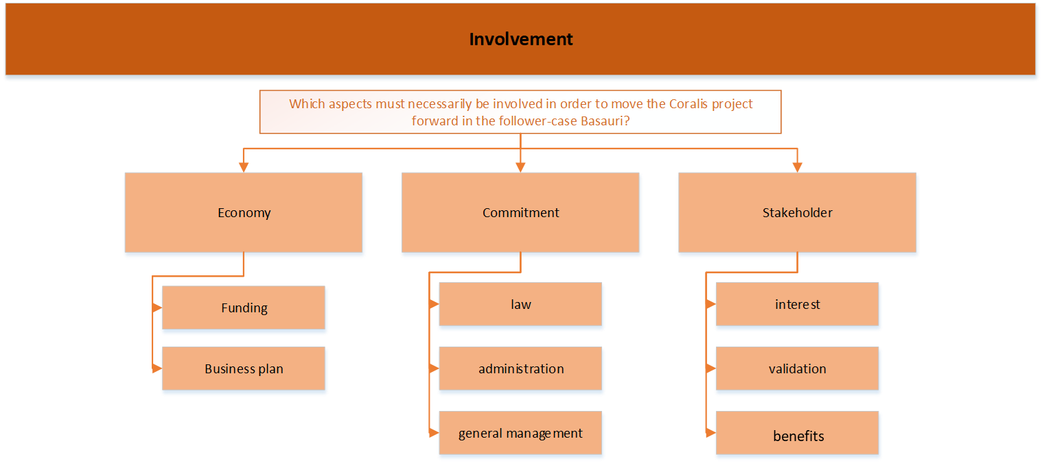
Stakeholder mobilization for enabling the implementation of the IS
Case specific results
Individual SWOT & results action for Stakeholder mobilisation – example of a follower case
Strenghts | Weaknesses
Local government is aware and positive of circularity improvements There is a lot of support (law, administration) Politics, national governments and region are helpful Higher energy prices support the use of district heating | Lack of interest from local administration Need of funding Need of more involvement Not enough commitment Dependency of others
Opportunities | Threats
Companies in cooperation can help each other High energy prices- can be reduced with waste recovery Strengthen the market position Demand of green steel is growing Project on district heating are a very current topic | Do companies really want to give insights into their approach? -open exchange of information Not having clear defined goals Too worried about what might happen Industrial sites are not fully optimized

Slide 23
Stakeholder mobilization for enabling the implementation of the IS
Case specific results
Individual SWOT & results action for Stakeholder mobilisation – example of a follower case
Strenghts | Weaknesses
Coralis has shown the possibilities to start conversations Synergies with other EU projects have occurred Usage of existing network is extremely helpful Building on knowledge (why caustic is not suitable in some industries) Contacts to pulp & paper and cardboard industry | Outlook on a possible outcome is missing Communication needs to be a steady process Still need of finding a process to spend caustic almost untreated Old practices for usage of caustic in some industries
Opportunities | Threats
Finding other industries (like farming, agriculture) Investments for usage (paper, metal industry) Paper industry is huge in Turkey Workshops have revealed many interested industries Investments increase for “green transition” | Legal barriers Confidential issues Technical issues (waste product has impurities therefore can not be used in human-skin industry) Need of high investments Transition is hard for a refinery
2024/10/08
WEBINAR stakeholder mobilisation & roadmapping / EI-JKU
23

Slide 24
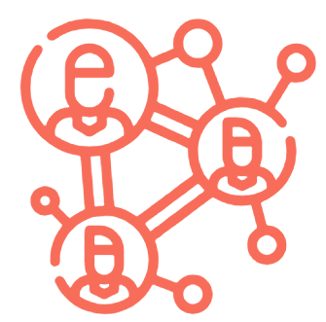
Stakeholder mobilization for enabling the implementation of the IS
Methods for Stakeholder Mobilization in Industrial Symbiosis
Stakeholder Workshops - Organize interactive sessions to encourage collaboration.
Pilot Projects - Demonstrate benefits through small-scale initiatives.
Site Visits and Study Tours - Allow stakeholders to witness successful projects firsthand.
Industry-specific Task Forces - Create focused groups for sector-specific guidelines.
Financial Support - Explore funding options and highlight ROI.
Collaboration Platforms - Develop online spaces for resource exchange.
Demonstration Events - Showcase project outcomes to a wider audience.
Public-Private Partnerships - Collaborate with governments and the private sector.
Communication and Outreach - Tailor messages to engage different stakeholders.
Monitoring and Evaluation - Measure and communicate the impact of symbiotic initiatives
2024/10/08
WEBINAR stakeholder mobilisation & roadmapping / EI-JKU
24

Slide 25

Stakeholder mobilization for enabling the implementation of the IS
Recommendations for Stakeholder Mobilization in Industrial Symbiosis
Awareness Campaigns - Educate stakeholders about industrial symbiosis through workshops,
seminars, and webinars.
Stakeholder Mapping - Identify and engage potential stakeholders effectively.
Collaboration Platforms - Create spaces for information exchange and partnership development.
Incentives and Benefits - Communicate the advantages of industrial symbiosis.
Policy Support - Advocate for supportive policies and frameworks.
Capacity Building - Empower stakeholders with training programs and workshops.
Case Studies and Best Practices - Showcase successful examples to inspire others.
Networking and Partnerships - Facilitate collaboration among stakeholders.
2024/10/08
WEBINAR stakeholder mobilisation & roadmapping / EI-JKU
25

Slide 26
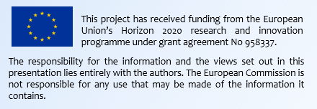


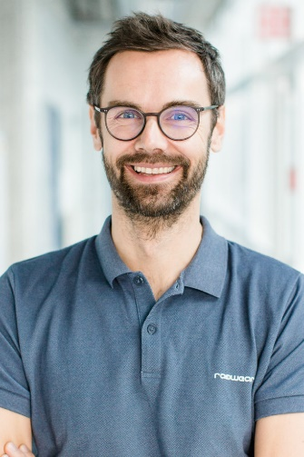


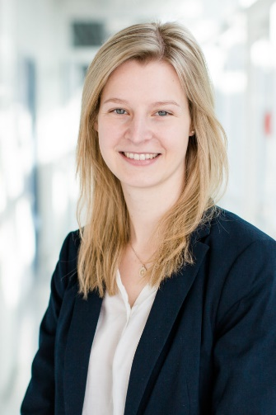


You are welcome to contact us!
Marianna Kambanou
Linköping University, Sweden
marianna.kambanou@liu.se
www.coralis-h2020.eu
infocoralis@fcirce.es
Johannes Lindorfer
Energy Institute at the Johannes Kepler University Linz, Austria
lindorfer@energieinstitut-linz.at
CORALIS EU project
@CoralisEu #CoralisEu
Melanie Knöbl
Energy Institute at the Johannes Kepler University Linz, Austria
knoebl@energieinstitut-linz.at
@CORALIS.EU

